Slide 1
Literature Reviews
Doing Political Research

Slide 2

Why Review the Academic Literature?
Essential early step in the research process (and continues throughout)
Has your research question been answered before? If so, how? In what context?
Demonstrate relevance, importance and/or novelty of your proposed research
Where does your research fit into wider academic discussions, theoretically and empirically?

Slide 3
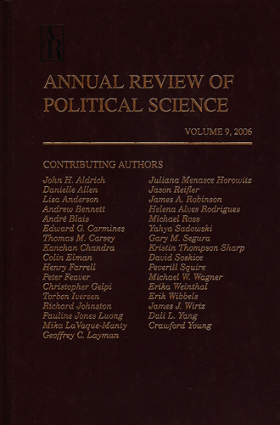


How to Find Relevant Literature
Textbooks
Review publications: Handbooks, Oxford Bibliographies, Annual Review of Political Science
Databases and search tools: Google Scholar, Social Sciences Citation Index, JSTOR, EBSCOhost
Recent articles on the topic (who is cited?)
Older articles (who cites them?)

Slide 4


Types of Academic Literature
Peer reviewed
Books
Journal articles
Chapters in edited volumes
Not peer reviewed
Working papers
‘Grey’ literature by think tanks and international organisations

Slide 5
What to Look For in the Literature
Questions to Ask
What are the main theories?
What methods have been used?
Where has research taken place?
When did research take place?
Are there any controversies or inconsistencies?
What is missing?
Being Critical
Literature reviews don’t just summarise the literature but assess and evaluate existing evidence
What assumptions have been made? Have they been evidenced?
What are the fundamental reasons behind theoretical/empirical controversies?
How will your research contribute to the literature?

Slide 6
Systematic vs Narrative Reviews
Narrative reviews
Telling a story about how the literature has developed, where it is going and what is missing
Systematic reviews
Clearly defined method for finding existing literature (eg which search terms were used on which databases)
Evaluation of existing literature based on a set of defined criteria and hierarchy of evidence
Systematic reviews used more in medical sciences, but may have some use in social sciences for certain questions (Dacombe)

Slide 7
Existing Literature as Data
Comparative case studies
Meta-analysis
Meta-ethnography

